Slide 1

Operational Amplifier and electronic devices
MAJOR-NORBERT APAI
PETRE FLORIN STAN
This Photo by Unknown author is licensed under CC BY.

Slide 2
Operational Amplifier and electronic devices
Contents
Definition
Classification
Internal structure and Parameters
Configuration Topologies
Other circuit components
Datasheet paper
Troubleshooting & Protection
Bibliography
Electronic Board

Slide 3
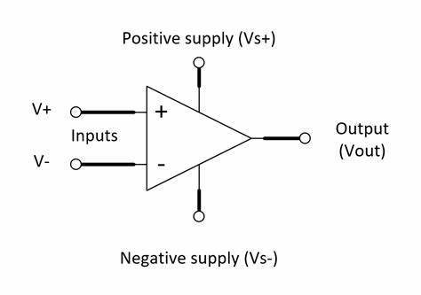
DEFINITION
OPERATIONAL AMPLIFIER AND ELECTRONIC DEVICES
Integrated circuit
Three terminals
Signal chain, power, and control applications

Slide 4
CLASSIFICATION
OPERATIONAL AMPLIFIER AND ELECTRONIC DEVICES
O
P
E
R
A
T
I
O
N
A
L
A
M
P
L
I
F
I
E
R
S
Four ways to classify operational amplifiers
Voltage amplifiers
Current amplifiers
Trans conductance amplifiers
Trans resistance amplifiers

Slide 5
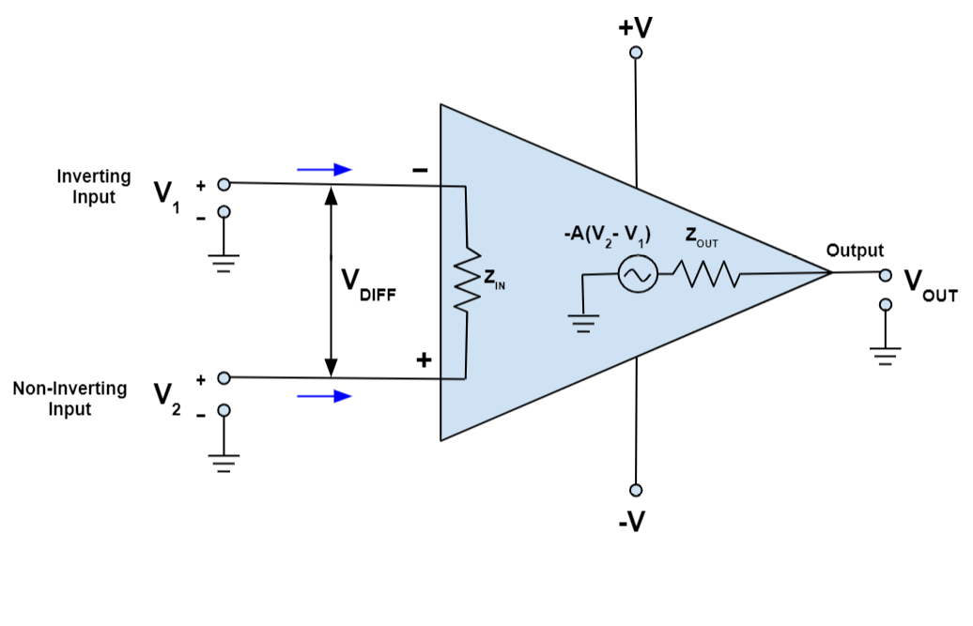
Internal Structure and parameters
OPERATIONAL AMPLIFIER AND ELECTRONIC DEVICES
Open-loop gain
Input impedance
Output impedance

Slide 6
Configuration Topologies
OPERATIONAL AMPLIFIER AND ELECTRONIC DEVICES
Non-inverting amplifier
Inverting amplifier
Non-inverting camparator
Inverting comparator
Amplifier circuits
Comparator circuits

Slide 7
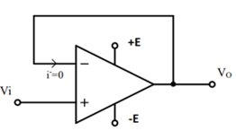
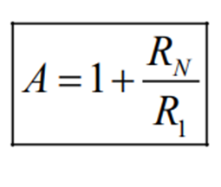
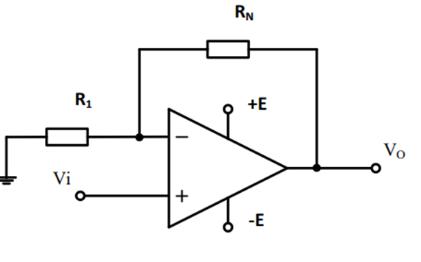
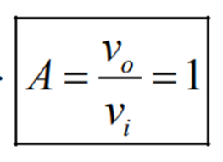
AMPLIFIER CIRCUITS
OPERATIONAL AMPLIFIER AND ELECTRONIC DEVICES
Non-inverting amplifier

Slide 8
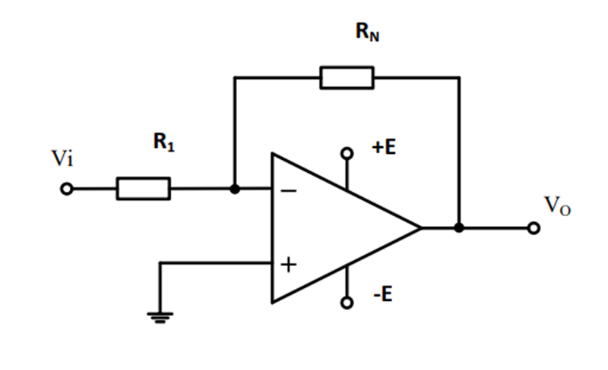
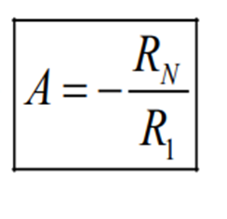
AMPLIFIER CIRCUITS
OPERATIONAL AMPLIFIER AND ELECTRONIC DEVICES
Inverting amplifier

Slide 9
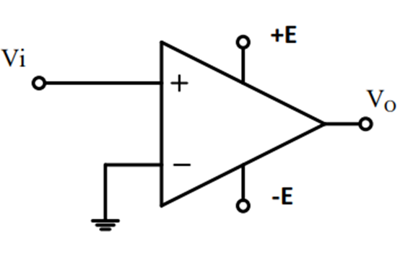
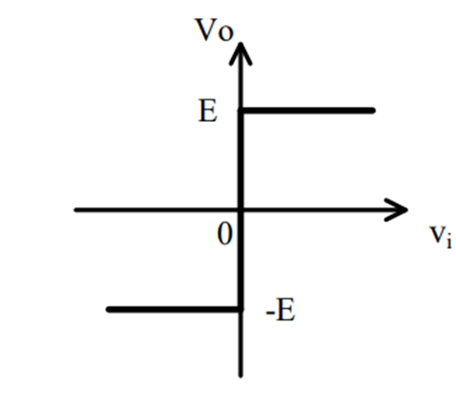
Comparator CIRCUITS
OPERATIONAL AMPLIFIER AND ELECTRONIC DEVICES
Non-inverting comparator without reaction

Slide 10
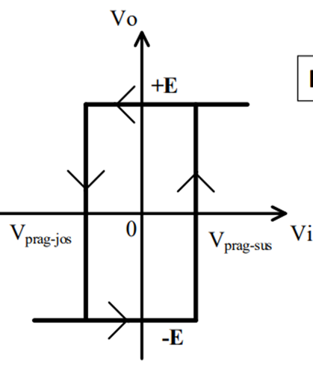
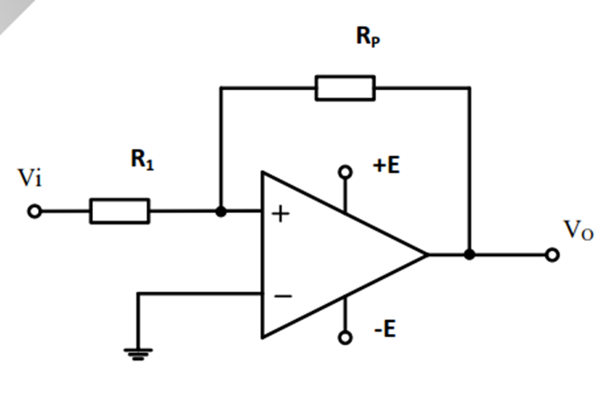
Comparator CIRCUITS
OPERATIONAL AMPLIFIER AND ELECTRONIC DEVICES
Non-inverting comparator with reaction

Slide 11
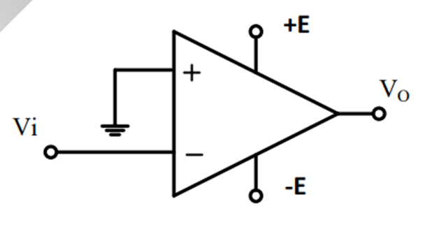
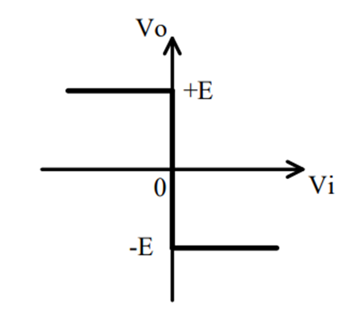
Comparator CIRCUITS
OPERATIONAL AMPLIFIER AND ELECTRONIC DEVICES
Inverting comparator without reaction

Slide 12
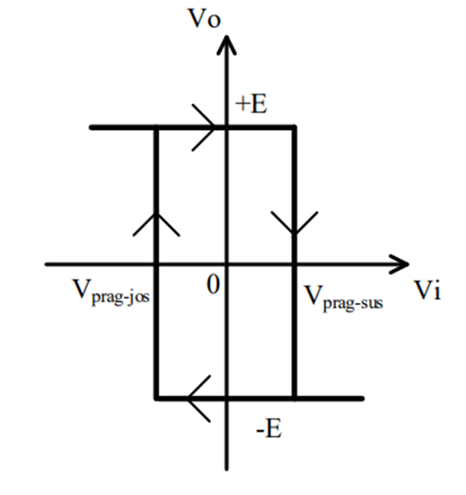
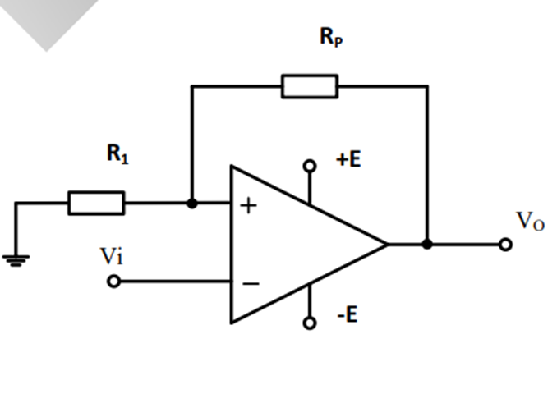
Comparator CIRCUITS
OPERATIONAL AMPLIFIER AND ELECTRONIC DEVICES
Inverting comparator with reaction

Slide 13
OPERATIONAL AMPLIFIER AND ELECTRONIC DEVICES
Other types of Amplifier circuits:
Summing
Differential
Derivation
Integration
Exponentiation
Logarithmic
Digital-analog converters with weighted resistors
Digital-analog converters with R-2R network
Instrumentation amplifier

Slide 14
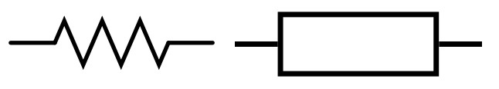
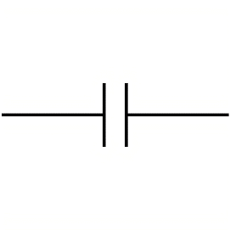

OPERATIONAL AMPLIFIER AND ELECTRONIC DEVICES
Resistors
Capacitors
Coils
Other circuit components:
Diodes
Transistors
Rectifiers

Slide 15
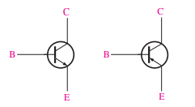
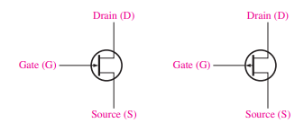
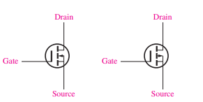
OPERATIONAL AMPLIFIER AND ELECTRONIC DEVICES
Types of transistors:
bipolar junction transistor
metal oxide-semiconductor field-effect transistor
junction field effect transistor

Slide 16
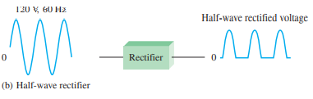
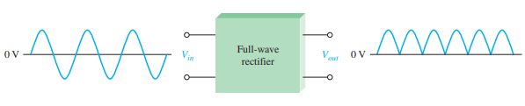
OPERATIONAL AMPLIFIER AND ELECTRONIC DEVICES
Special-purpose diodes
Types of Rectifiers
The Photodiode
The Light Emitting Diode
The Zener Diode
The Tunnel Diode
The Current Regulator Diode
The Schottky Diode
Half-Wave Rectifiers
Full-Wave Rectifiers

Slide 17
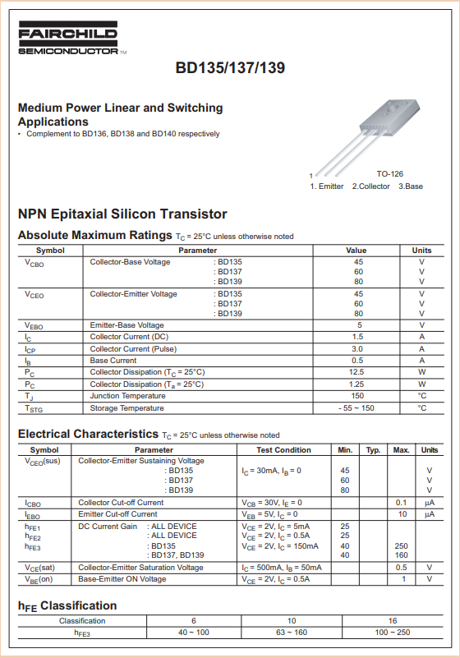
OPERATIONAL AMPLIFIER AND ELECTRONIC DEVICES
Datasheet paper

Slide 18
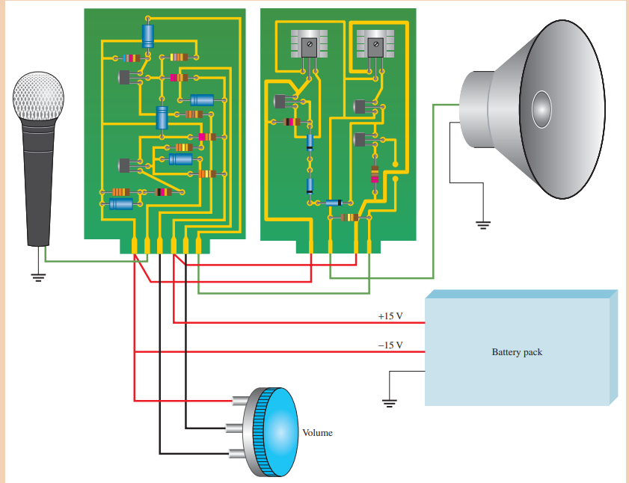
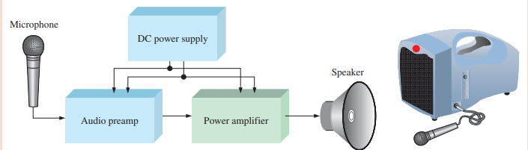
OPERATIONAL AMPLIFIER AND ELECTRONIC DEVICES
Block diagrams

Slide 19
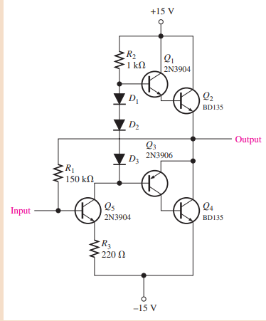
OPERATIONAL AMPLIFIER AND ELECTRONIC DEVICES
The Power Amplifier Circuit

Slide 20
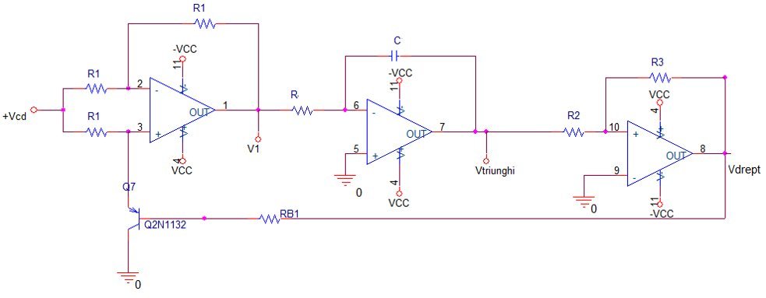
OPERATIONAL AMPLIFIER AND ELECTRONIC DEVICES
Signal generator

Slide 21
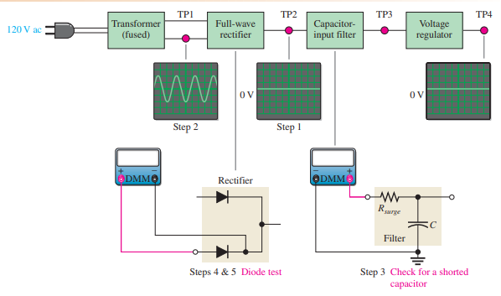
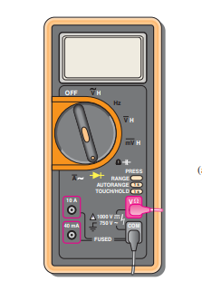
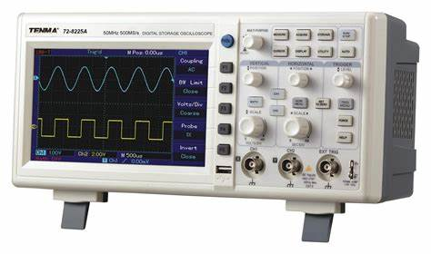
OPERATIONAL AMPLIFIER AND ELECTRONIC DEVICES
Troubleshooting and Protection
Steps
Analysis
Planning
Measurement
Digital Multimeter(DMM)
Oscilloscope

Slide 22

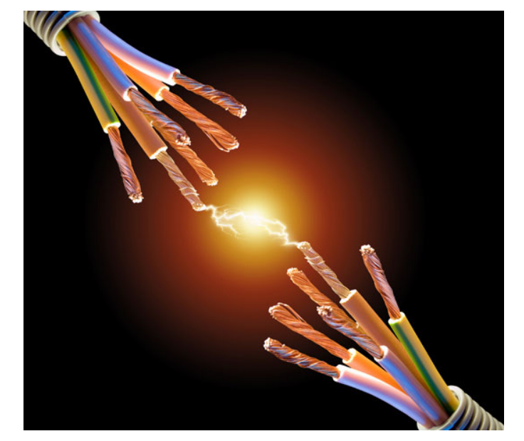
OPERATIONAL AMPLIFIER AND ELECTRONIC DEVICES
Protection against hazards such as:
Overheat
Electrostatic discharge
Moisture
Vibration
Self-protection
The use of electrically insulating gloves
Cable insulation
Cleanliness around the devices
Avoiding the power cable

Slide 23
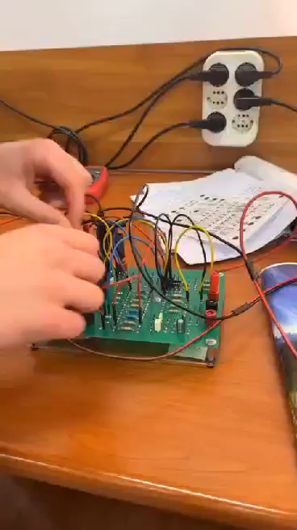
OPERATIONAL AMPLIFIER AND ELECTRONIC DEVICES

Slide 24
OPERATIONAL AMPLIFIER AND ELECTRONIC DEVICES
Bibliography
Thomas L. Floyd, (2011). Electronic Devices (9th edition). New York . pp 976.
https://www.monolithicpower.com/en/operational-amplifiers

